Slide 1

Accident Severity Prediction using Seattle Accident Dataset
Applied Data Science Capstone Project
IBM - Coursera
Karthik J Ghorpade
September 2020

Slide 2
An accident won’t arrive with a bell on its neck
An accident won’t arrive with a bell on its neck
- Finnish Proverb

Slide 3
Introduction
Vehicular accidents, no doubt, cause damage to people involved in the collision as well as property.
Severity of the accident mainly depends on the harm caused to humans rather than the property
Studies on existing collision data may lead to important insights into underlying causes which lead to accidents
This project is an attempt to predict severity of a possible futuristic accident based on existing collection of collision data

Slide 4
Business Problem | Application
The study performed in this project is on the Seattle Collision data
Authorities such as Seattle PD can benefit from such a study in narrowing down causes of accidents and take steps to reduce severity of collisions
The people of Seattle can use such a study to take cautionary measures
Cities with geographical and structural similarities could also benefit

Slide 5
Data Collection and Exploration
Data made by Seattle GeoData – Collisions dataset
194763 instances of accidents – 37 attributes and class label attribute per instance
Data obtained has many missing values – needs preprocessing
The class label or the target class is used to classification:
Class ‘1’ signifies low severity – property damage due to collision
Class ‘2’ signifies high severity – harm to humans and possible property damage
The classes are imbalanced – large number of Class ‘1’ data compared to Class ‘2’

Slide 6
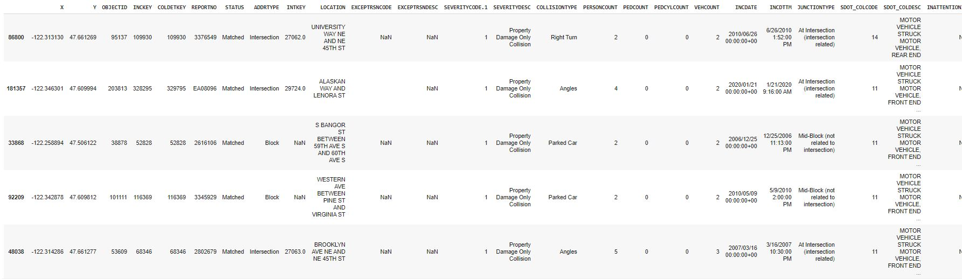
Data before cleaning
Many NaN values and missing values.

Slide 7
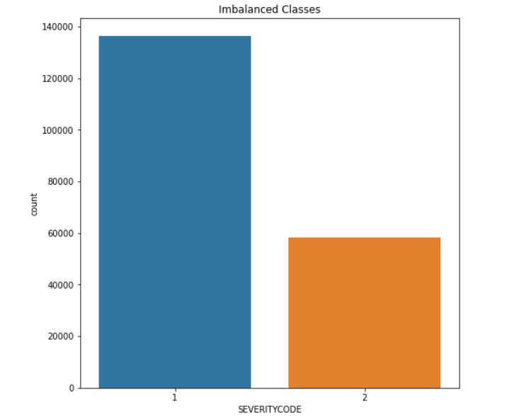
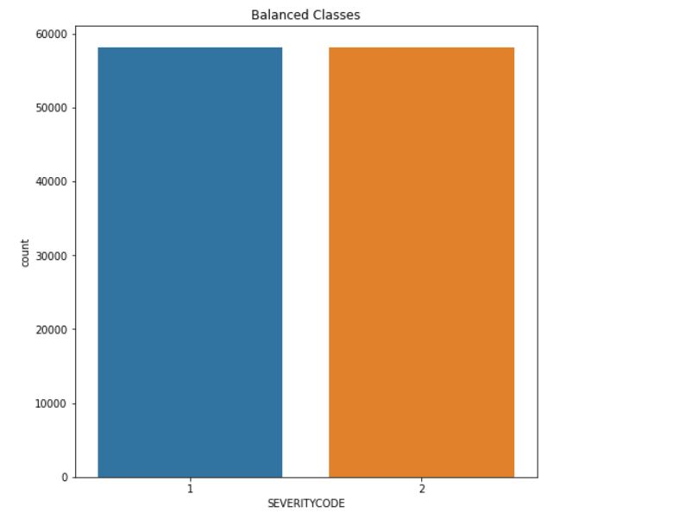
Balancing Imbalanced Data
The classes are balanced by down-sampling the majority class i.e. Class ‘1’

Slide 8
Data Pre-processing
Handling missing data
Label encoding categorical data
Column-wise data normalization
Choosing the suitable features

Slide 9
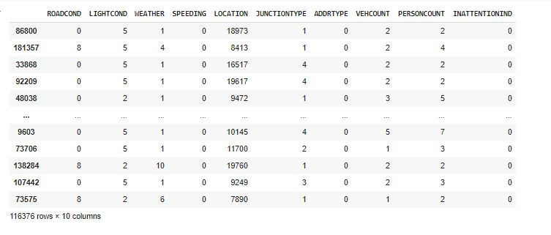
Data after pre-processing

Slide 10
Modelling
Train-test splitting of data
Choosing the appropriate algorithms
Hyperparameter tuning
Training with best parameters

Slide 11
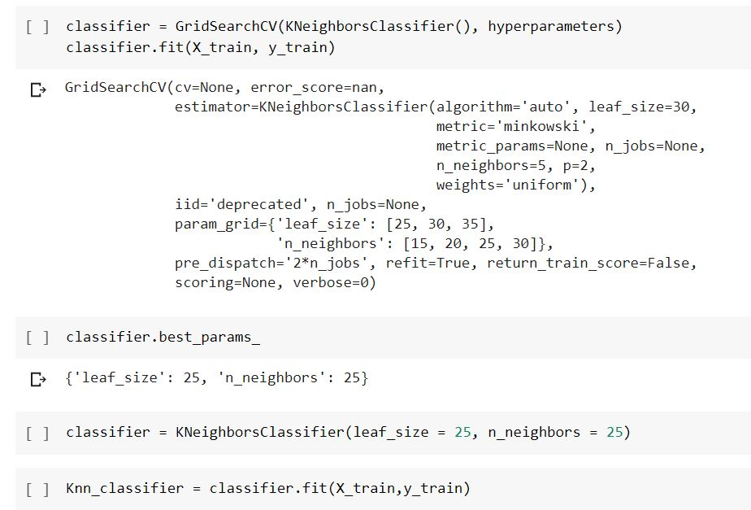
K-Nearest Neighbours Classifier
Hyperparameter tuning and training with best parameters

Slide 12
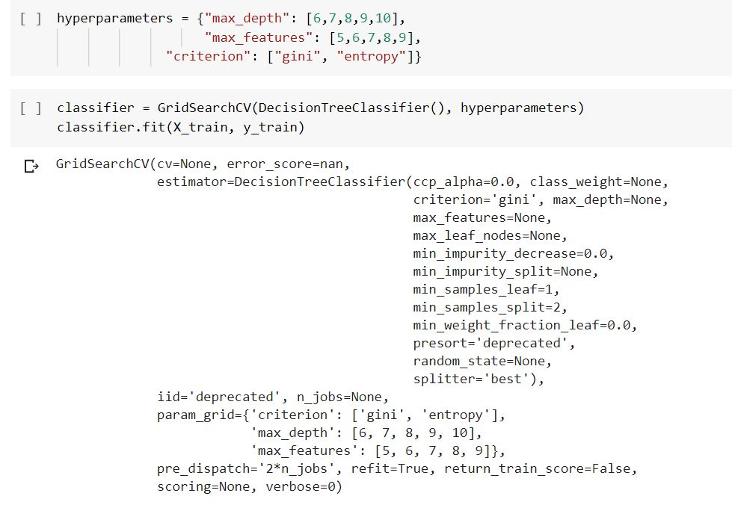
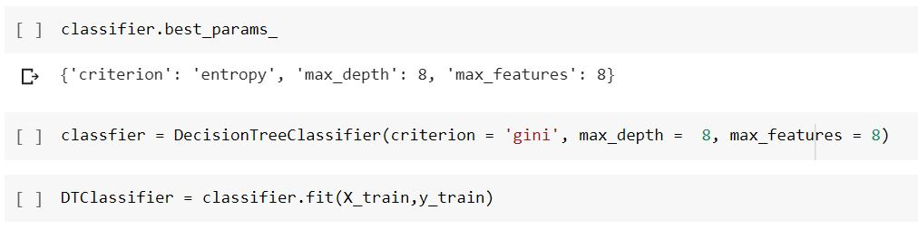
Decision Tree Classifier
Training with best parameters
Hyperparameter tuning

Slide 13
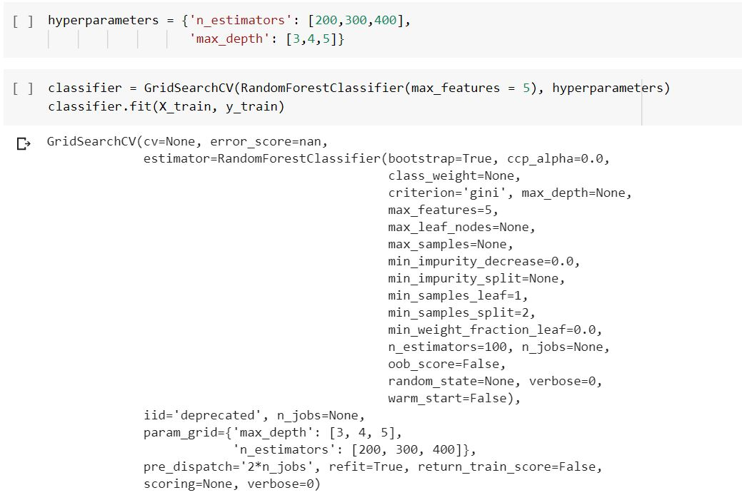
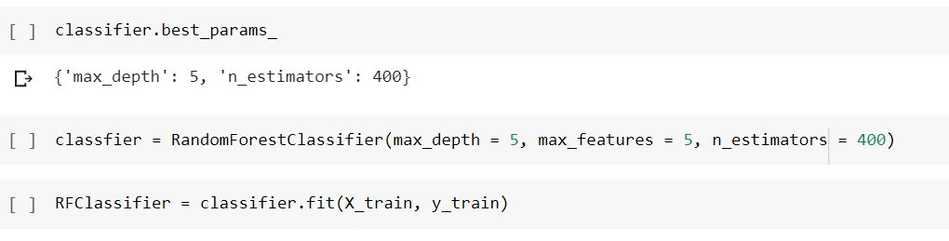
Random Forest Classifier
Training with best parameters
Hyperparameter tuning

Slide 14
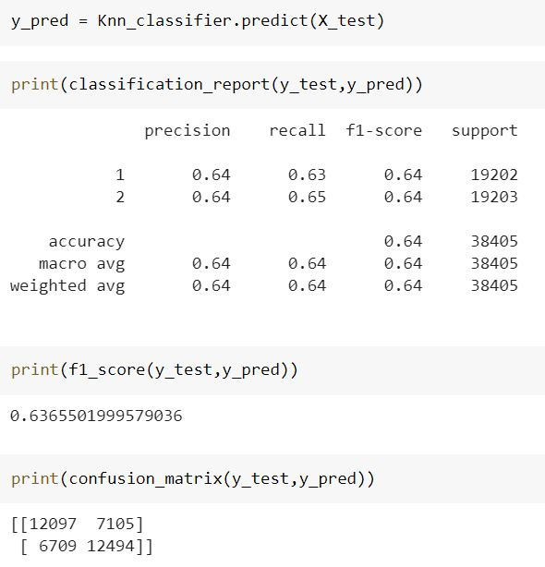
Evaluation – KNN Classifier
Performance Metrics

Slide 15
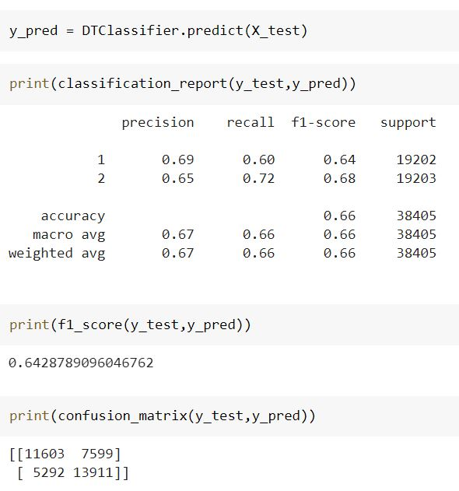
Evaluation – Dec. Tree Classifier
Performance Metrics

Slide 16
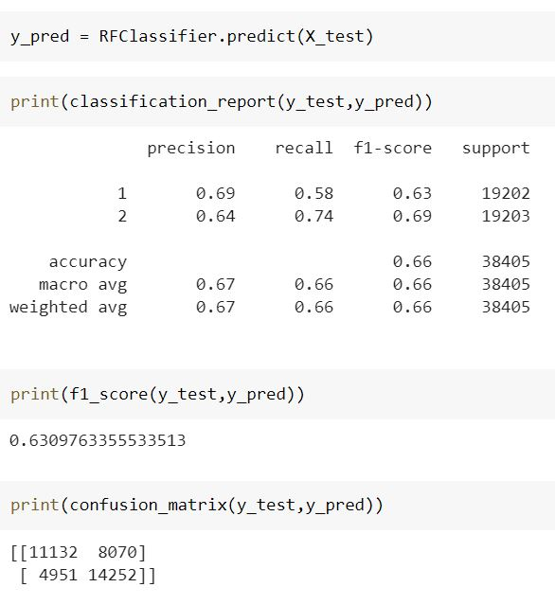
Evaluation – RF Classifier
Performance Metrics

Slide 17
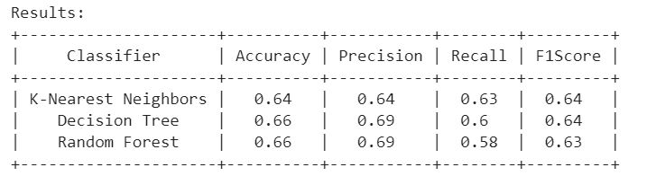
Consolidated Result | Conclusion
The accuracy of the models suggest that there is in fact 65% predictability of severity of accident based on collision and other attributes used in the model. This is very significant as these attributes could help in prediction and hence reduction of severity of possible accidents
From the final results obtained, it can be concluded that although there is some correlation between the features (such as weather, road condition, etc.,) and the severity of the accident but there is no concrete evidence of a pattern for classification.
Missing data handling, data preprocessing and feature selection are important steps involved in this project.
Advanced feature engineering techniques could provide concrete patterns for severity prediction

